Slide 1
Plan Pulse
Esai & Shreya

Slide 2
Thought
We want to have Focused time planner to spend maximum time towards goal
We also in need to have one common planner for our class, Since we receive many task with deadlines, we don’t want absentees to miss the information, so we want to update the class planner as well

Slide 3
Features
Enter to do list for the day with estimated time - done
After completing enter time spent – done
We want to enter the plans for future dates as well – done
We want to go back and see what we did on particular day and pending works
Whether same planner used for whole class as Class to do list planner

Slide 4
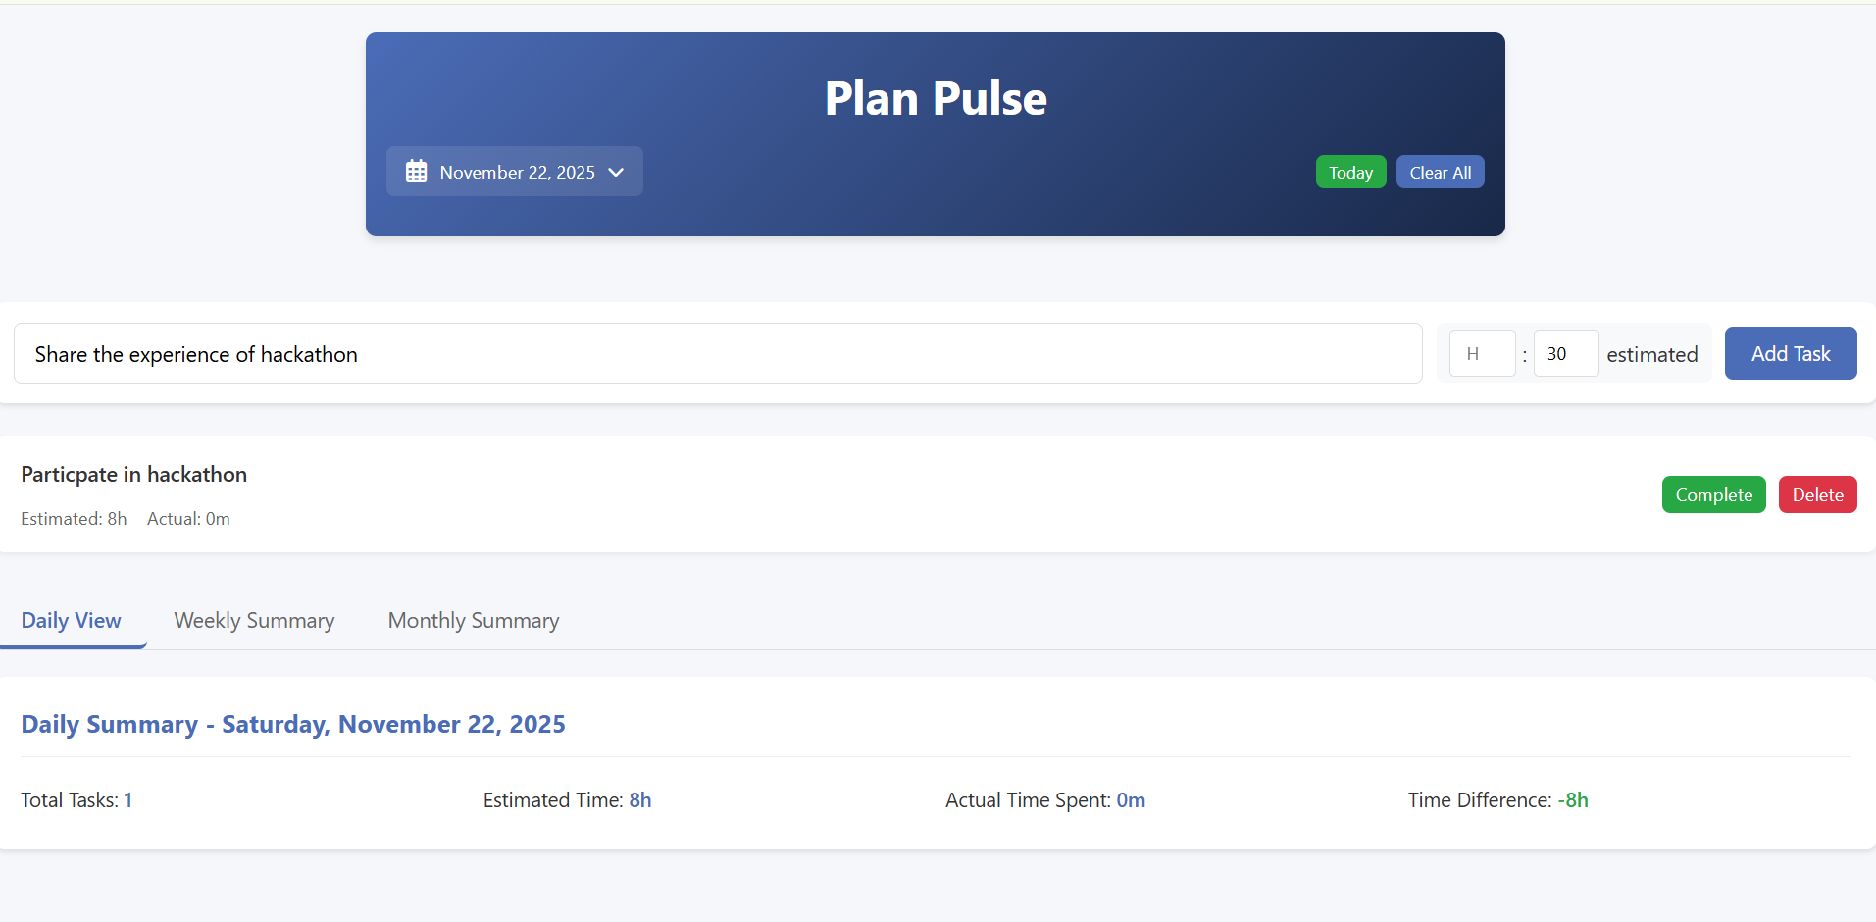
Add New To Do with Estimated Time

Slide 5
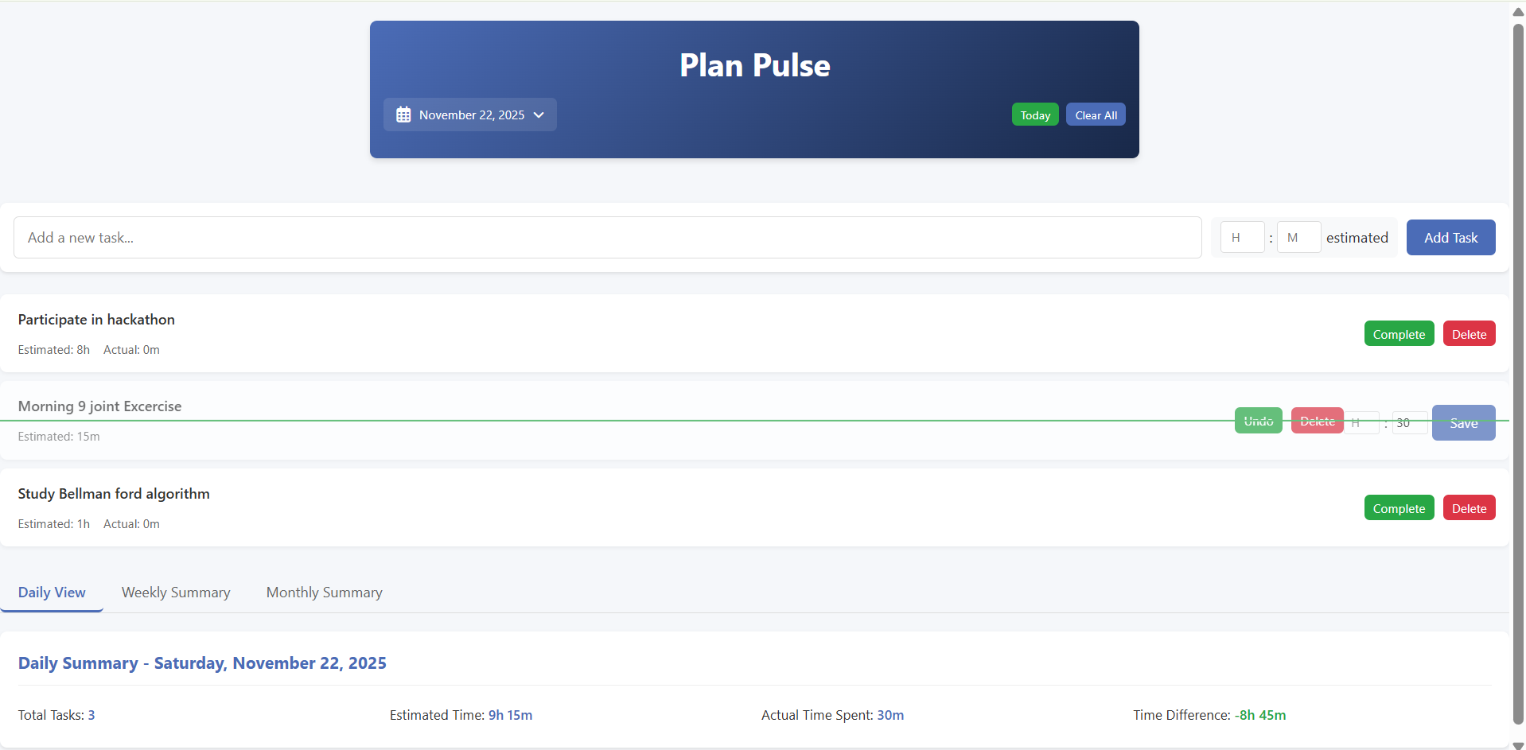
Actual Time Spent for Completed Tasks

Slide 6
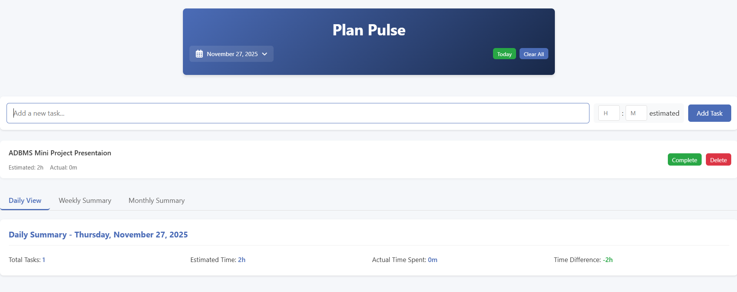
Schedule the future Plans

Slide 7
